Slide 1
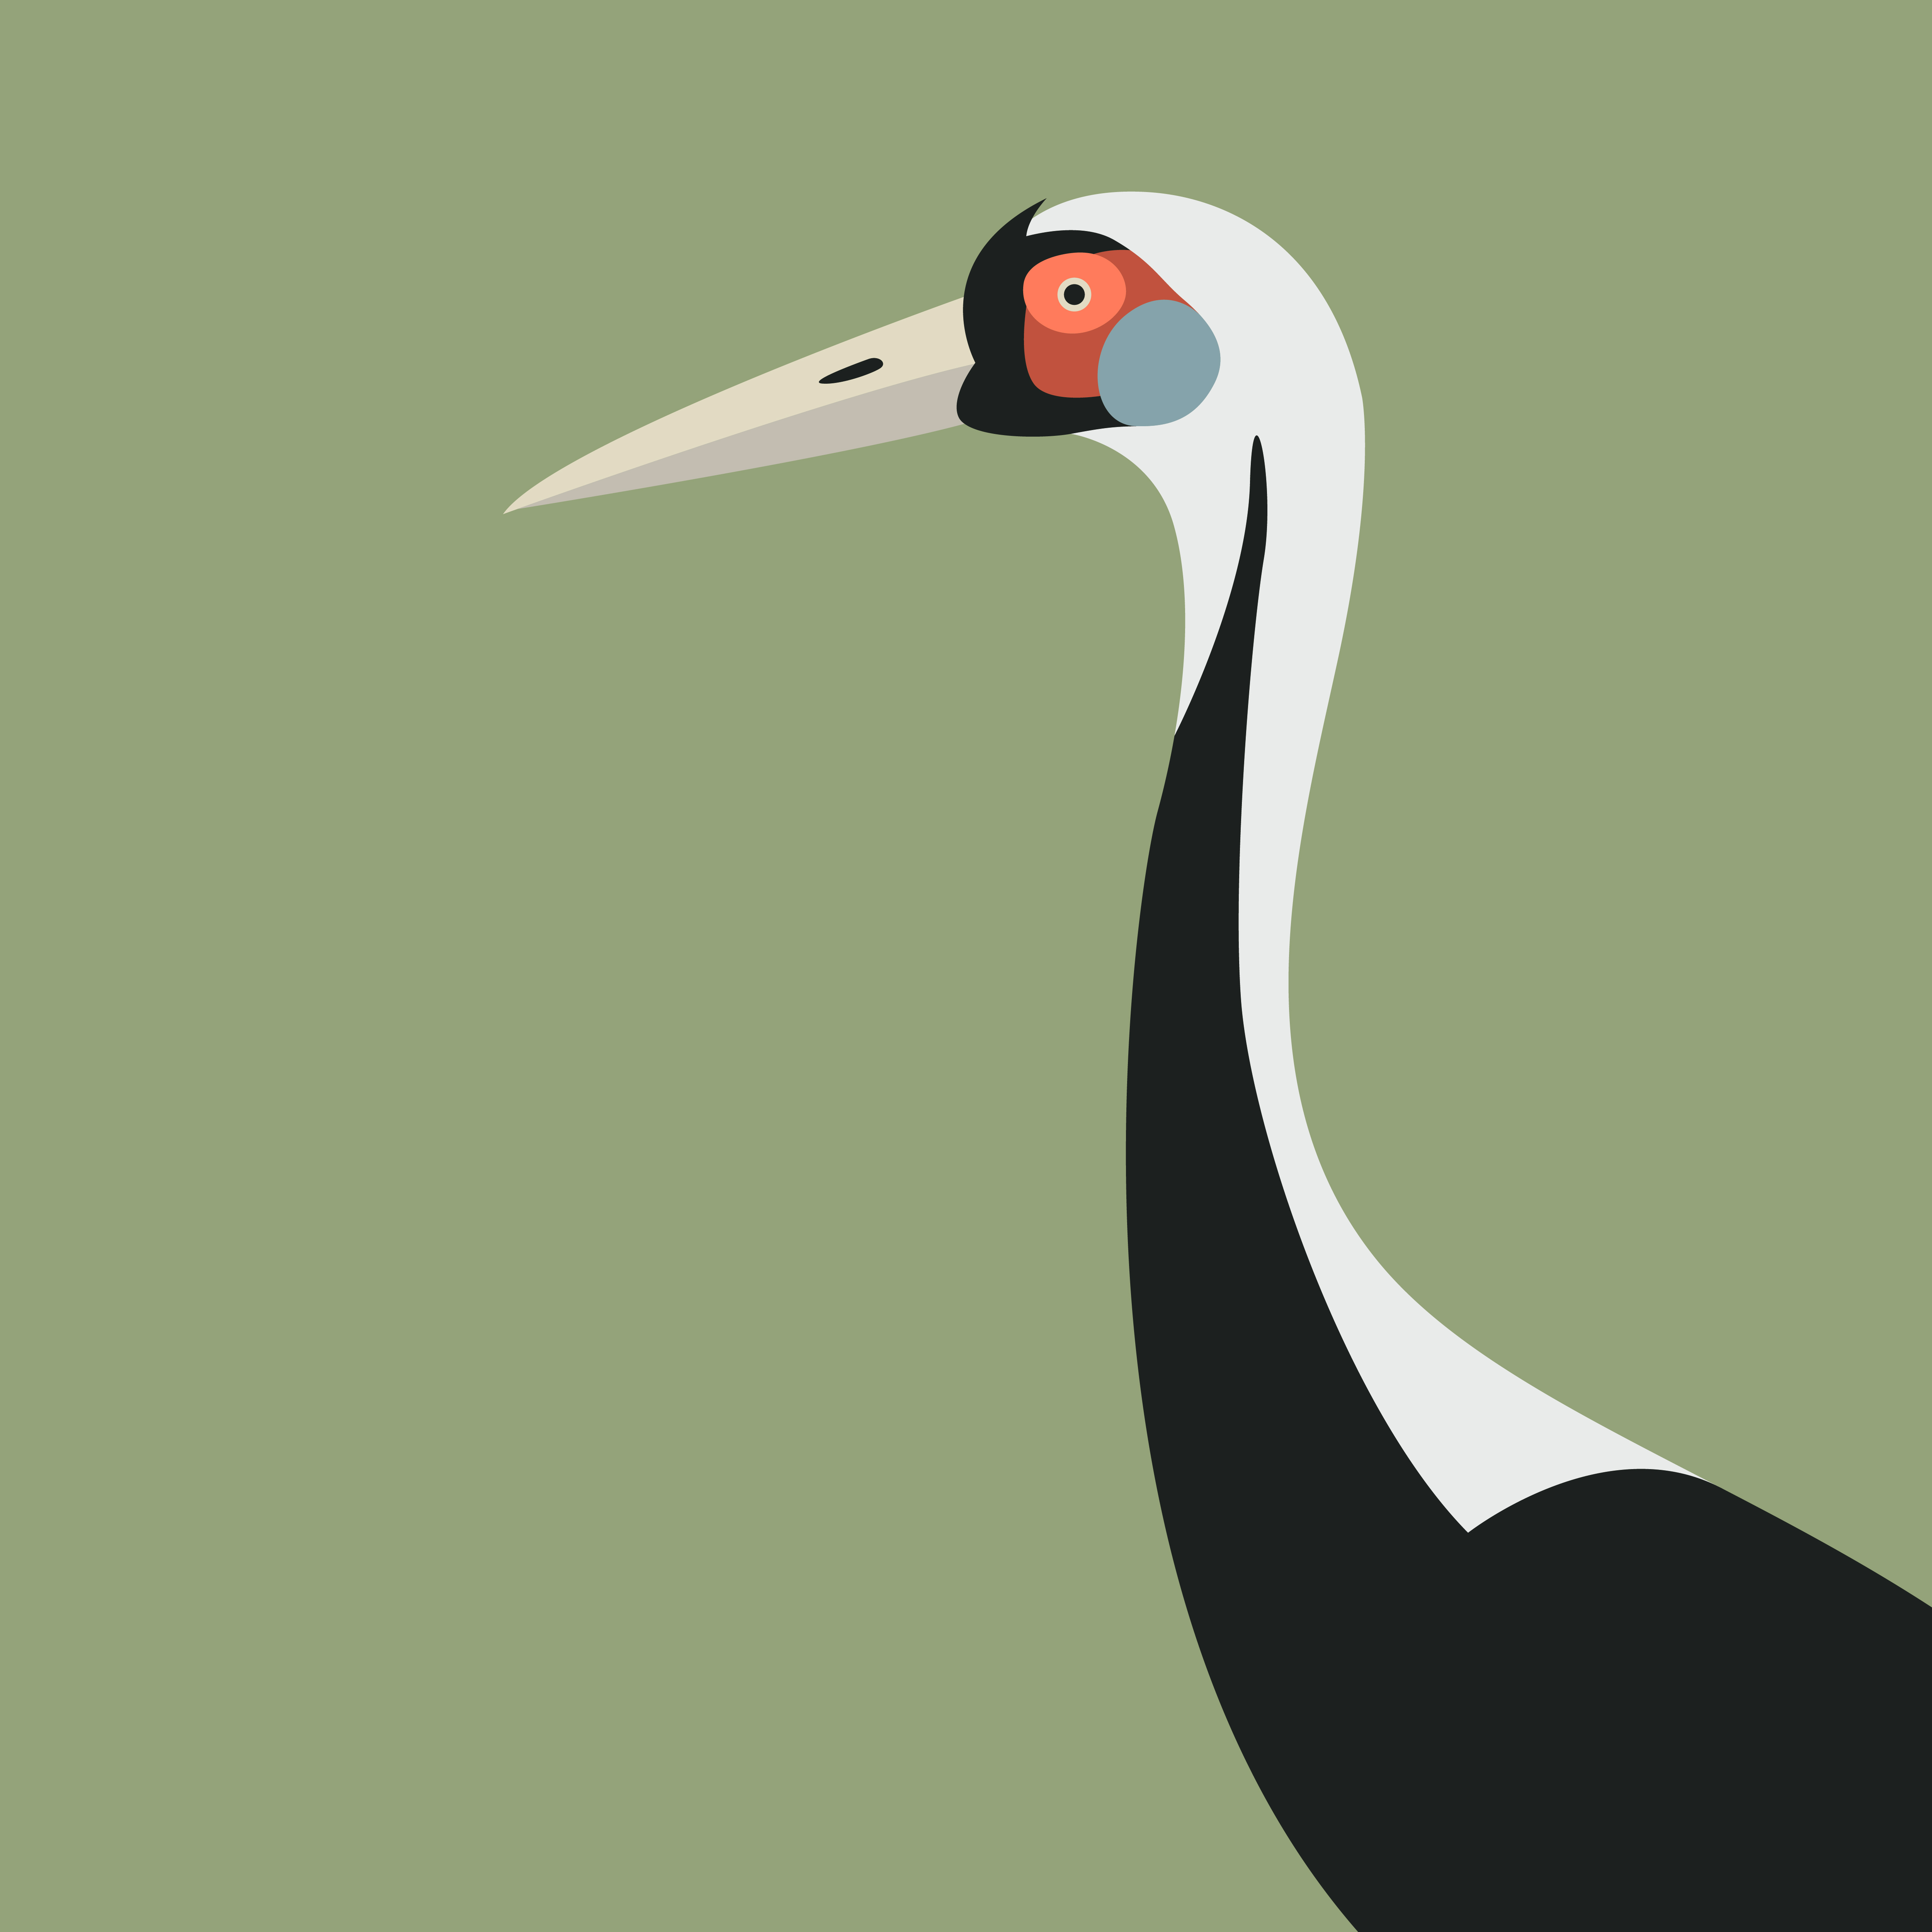
THE LOVE OF THE CRANE
An adaptation game from a real story
By Peinan Wang

Slide 2
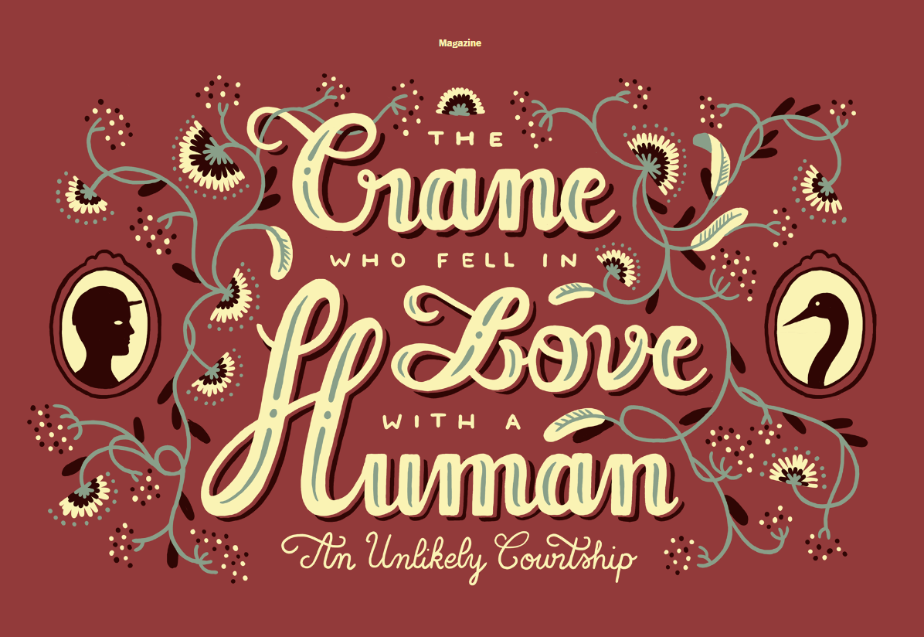
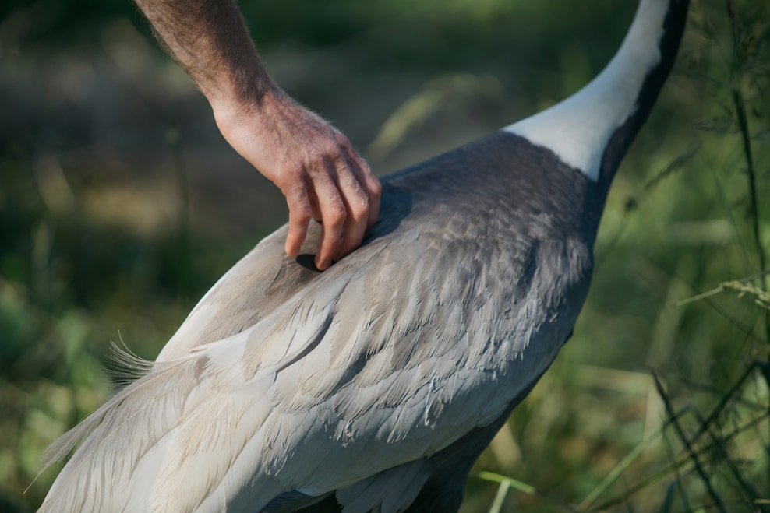

Slide 3
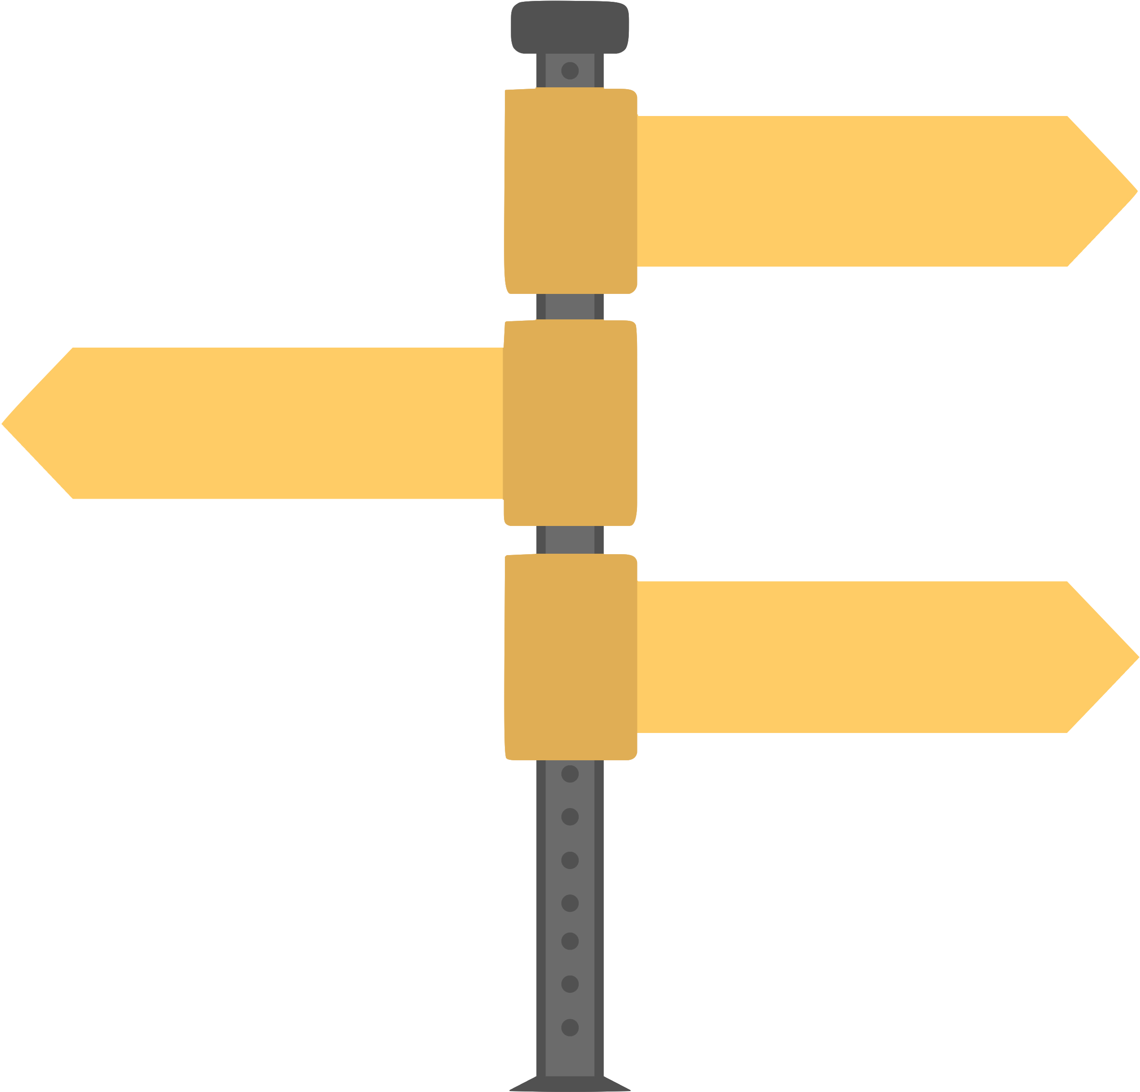
Content
Game Overview
Art Style
1
Scene Design
Fake Screen
2
Main Role (Crane)
Main Role (Keeper)
4
Gameplay System
3
Background Story
5
6
Reference

Slide 4
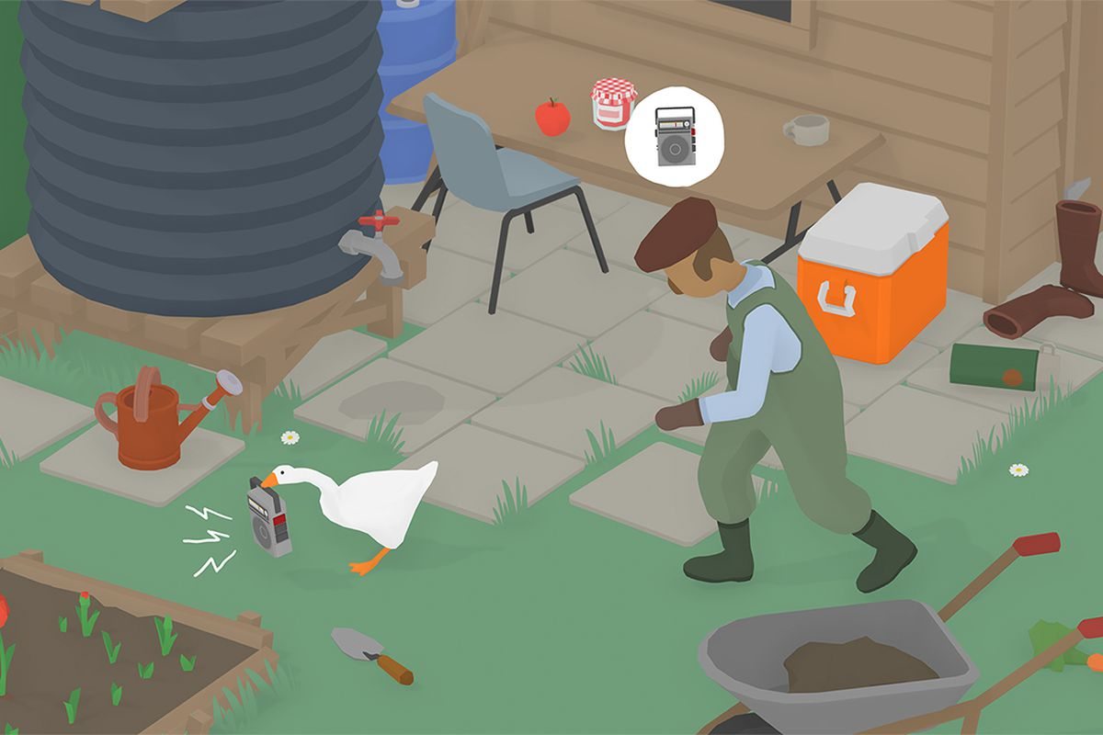
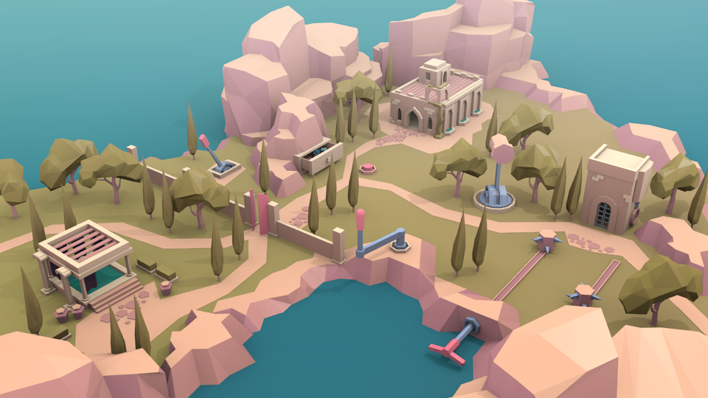
Game overview
Concept
Play as a bird keeper to raise a female crane which fall in love with him
Tags
Simulation game; interactive game
Camera
Orthographic; Lowpoly 3D; 45° depression angle; Follow the main character
Core Gameplay
Have a timeline in whole year, with 4 seasons. Feed, clean and play with the crane. Protect other cranes away from this female one. Make this female crane artificially inseminated.
Art Style
Reference:
“Untitled Goose Game”
http://goose.game
Reference:
hube³, Twitter
https://twitter.com/hubecube_
Use similar art style with Untitled Goose Game
Lowpoly picture style

Slide 5
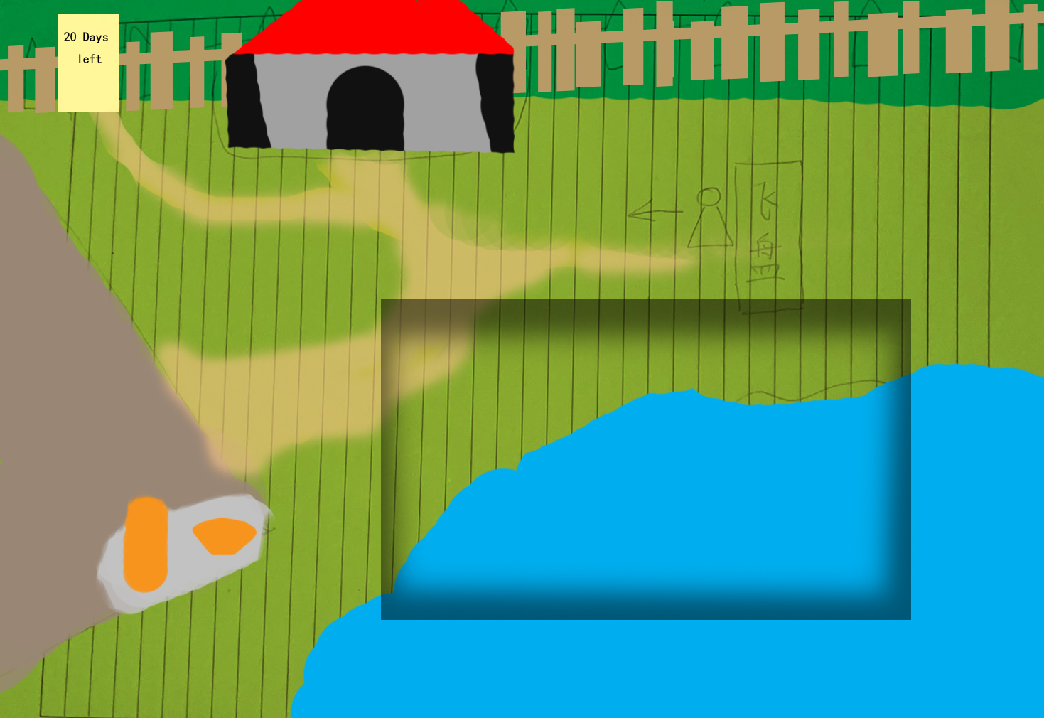

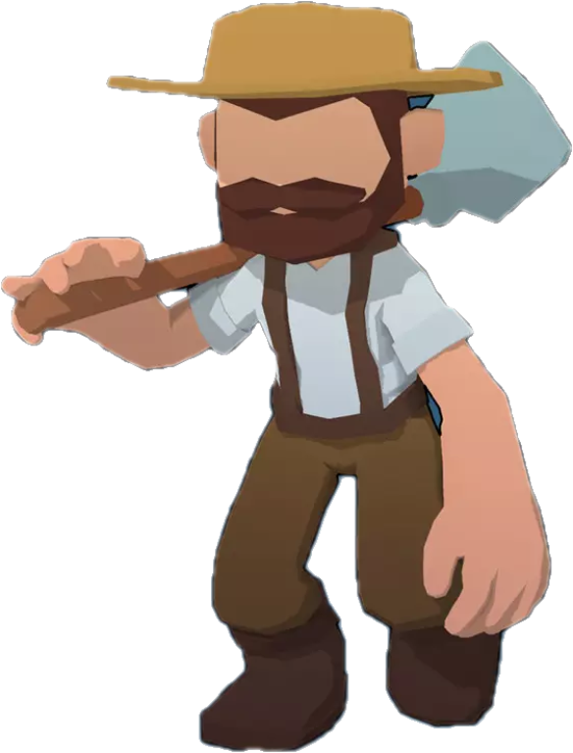
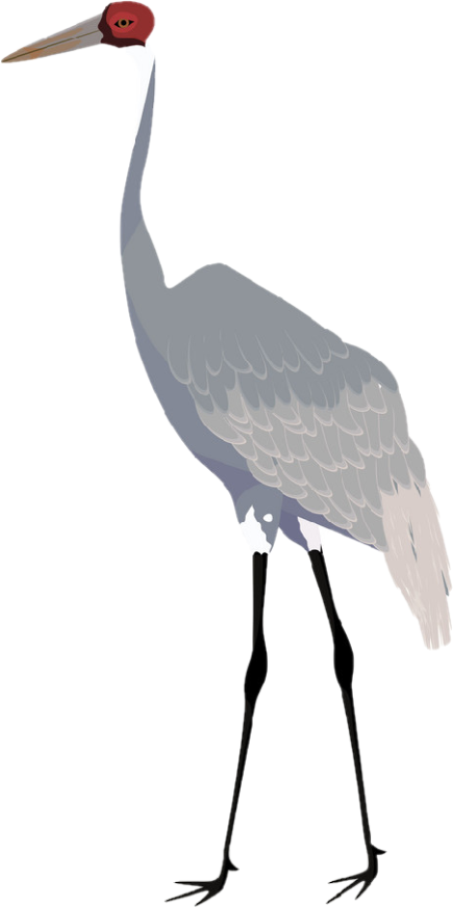
Scene Design
Storage with
food and tools
Position to play
fresibee with crane
Season and
date/Next day button
Gate with
Calender
Crane and
zookeeper’s size
The way that other
male cranes will enter
Barn
Where crane sleeps
Camera size
Place to put the
food and water
Pond for crane
to have fun

Slide 6
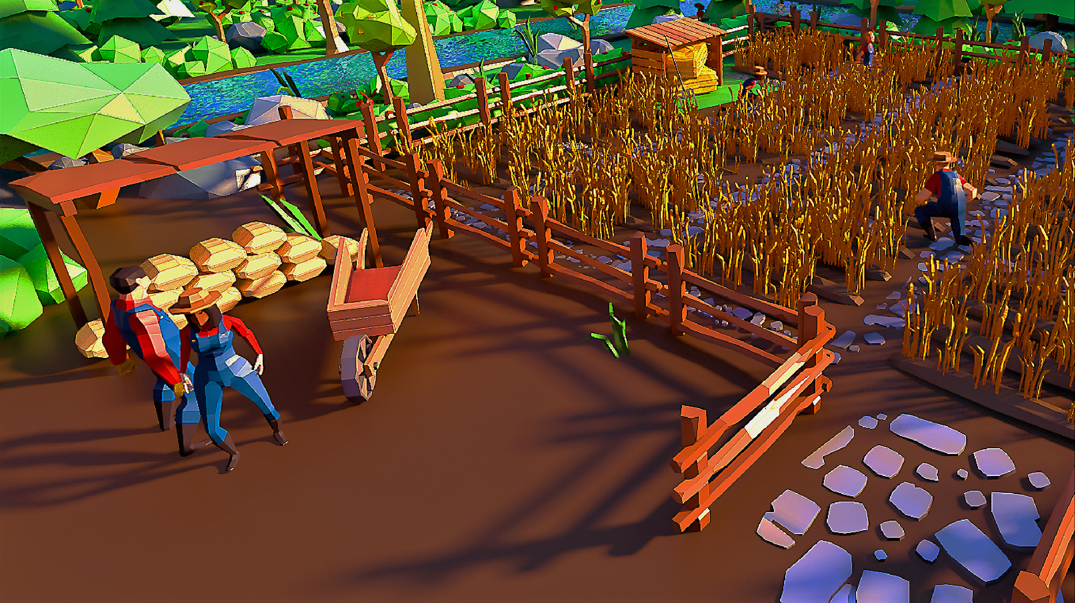
Fake Screen
Season and date
Crane Status
Tap crane to interact
Tap ground to
move

Slide 7
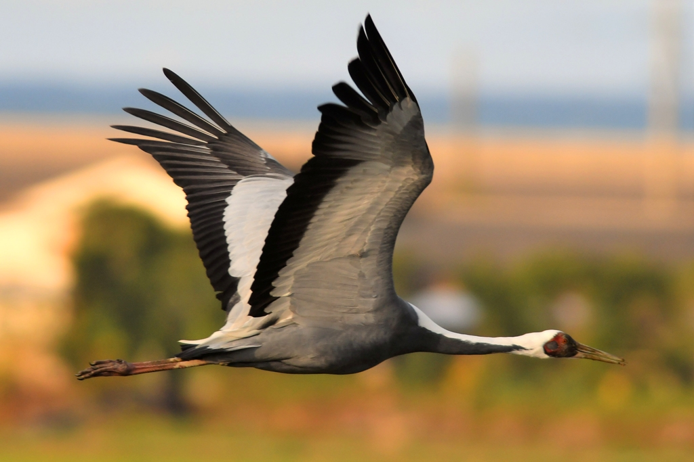
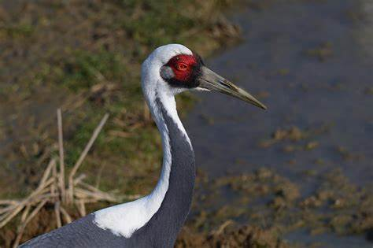
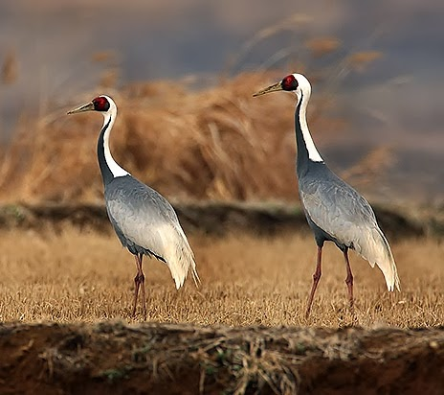
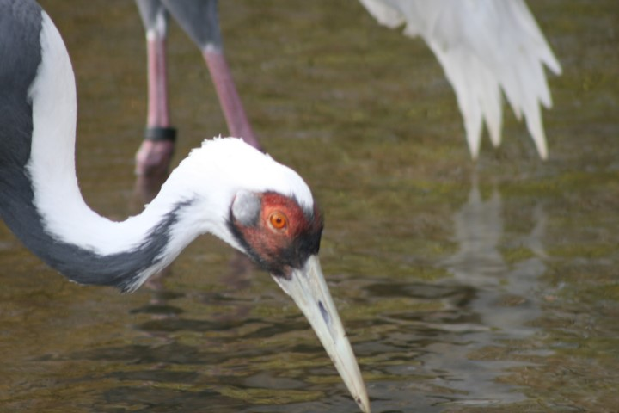
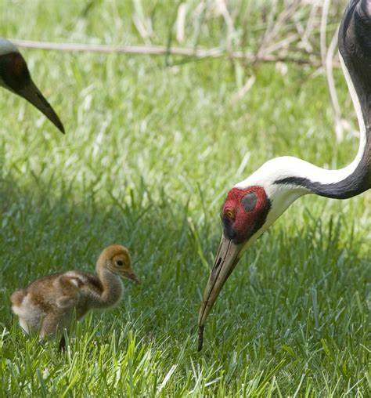
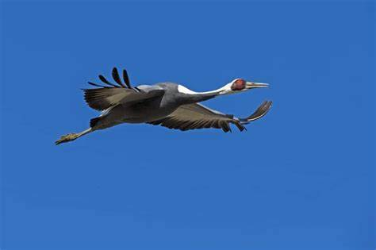
Crane Design
A white-naped crane that acts as though Crowe is her mate.
The crane act automatically, it is the main target which the player need to interact with.
The Crane has three band. They are the level of
happiness; health and intimacy. The crane will sick and die when the health level droping. When the level of happiness drops, the crane will refuse to interact with the player.
The white-naped crane, of which only 4,900 to 5,400 remain in the wild. The white-naped crane has a special behavior called "imprint". When they are raised by human and have never lived with a real white-naped crane, they may “imprint” on humans. When it’s time to looking for a suitable mate, these human-imprinted cranes will seek out a partner that looks like their presumed parent - a human. In this situation, the white crane will also show a repellent attitude toward other male cranes. So, it’s nearly impossible for the white-naped crane which imprinted humans to reproduce.
Reference:
White-naped crane From Wikipedia, the free encyclopedia
https://en.wikipedia.org/wiki/White-naped_crane

Slide 8
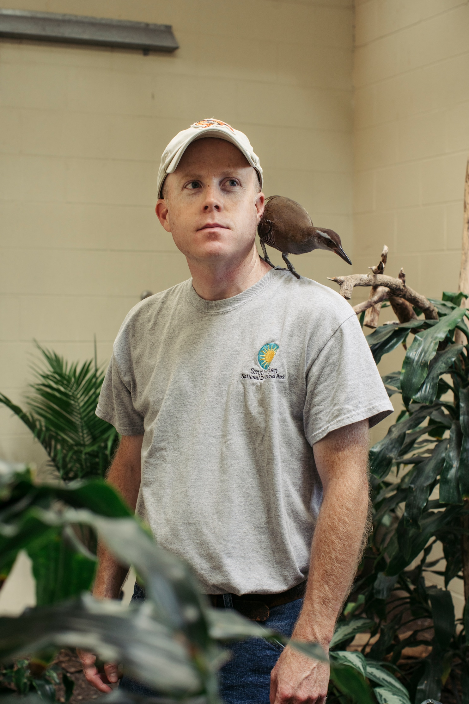
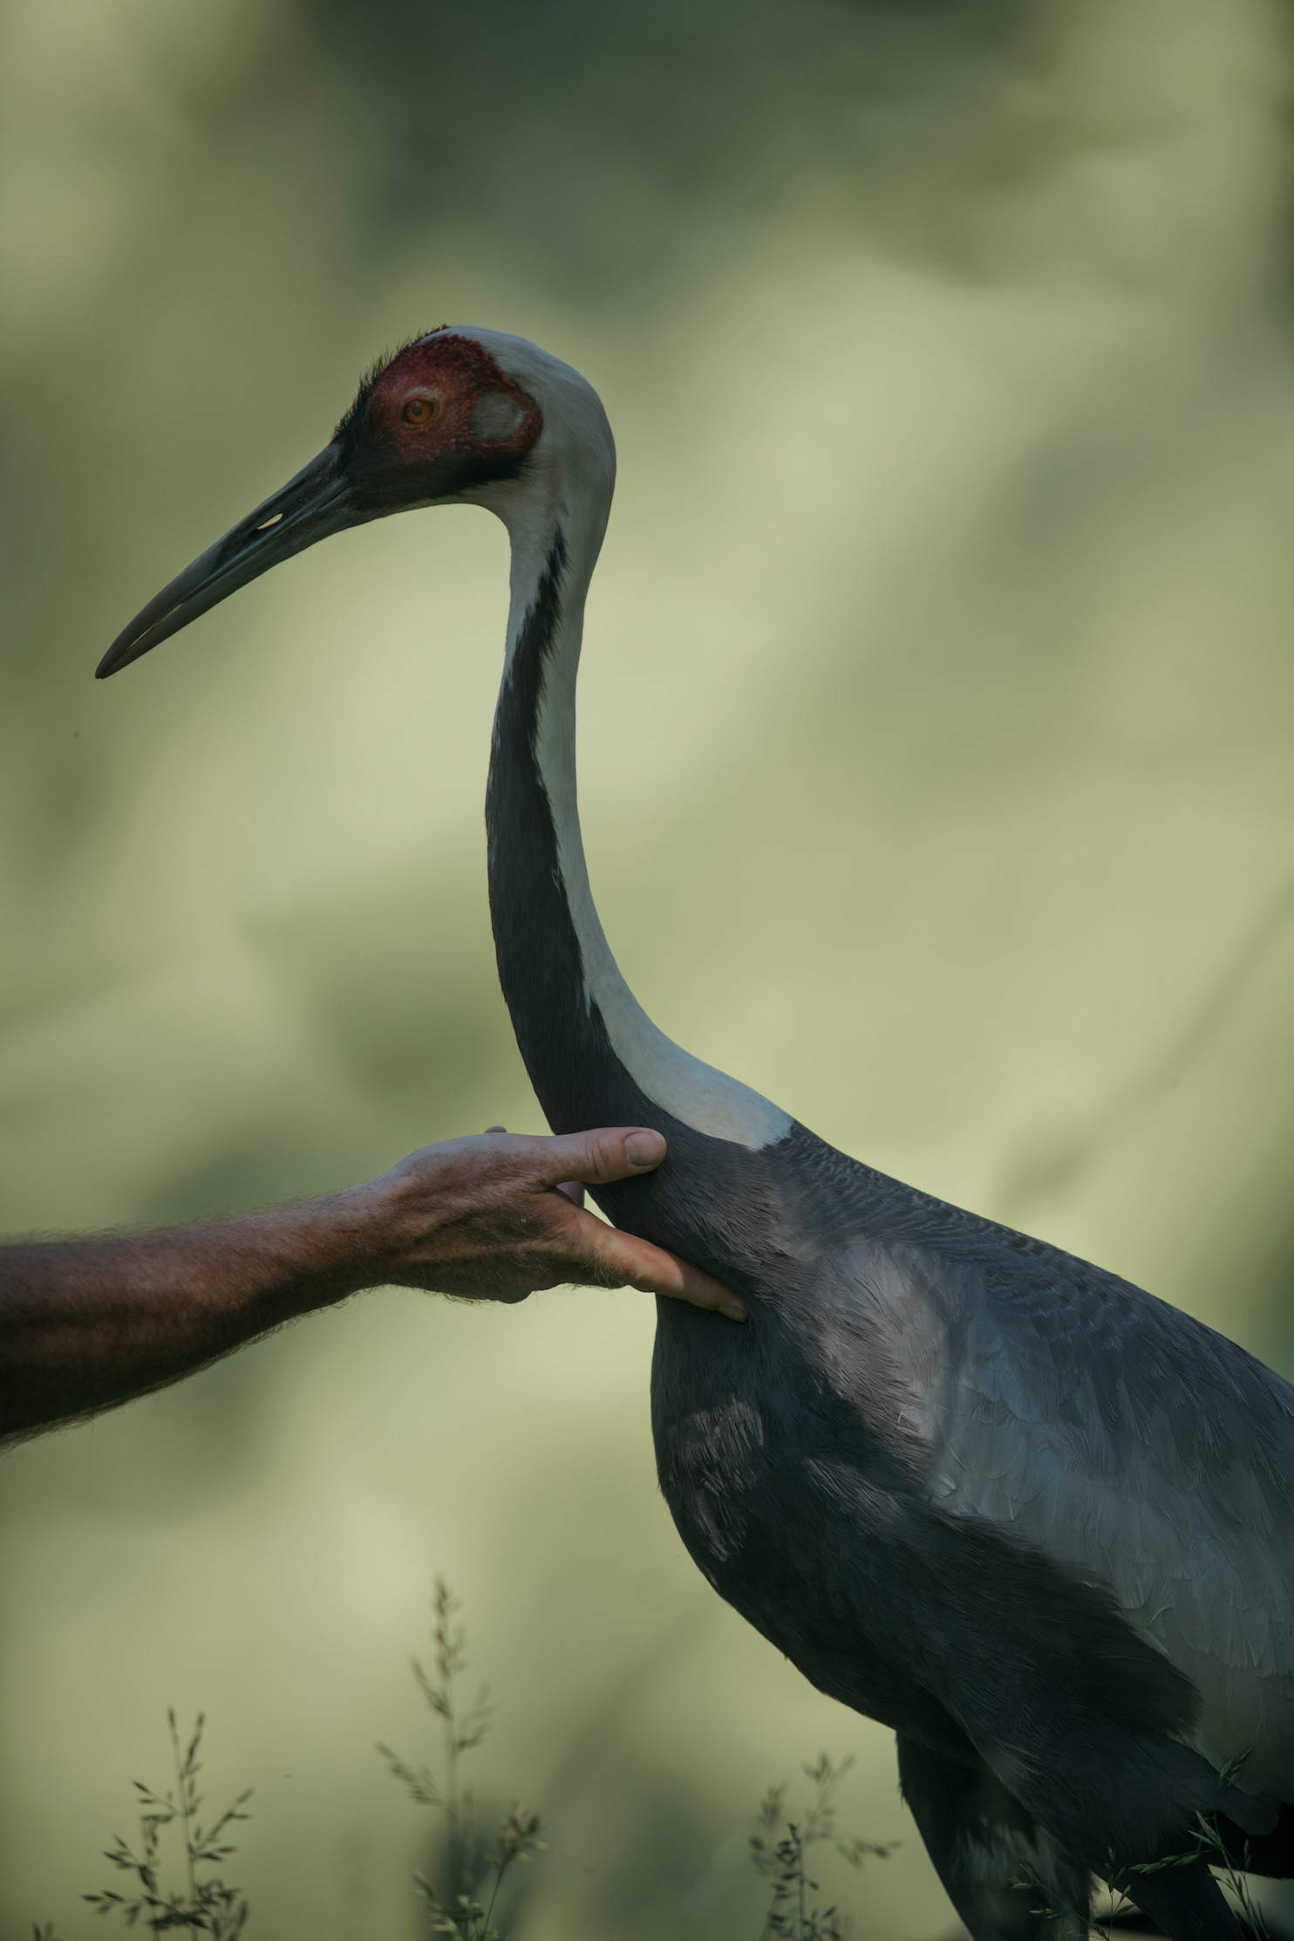
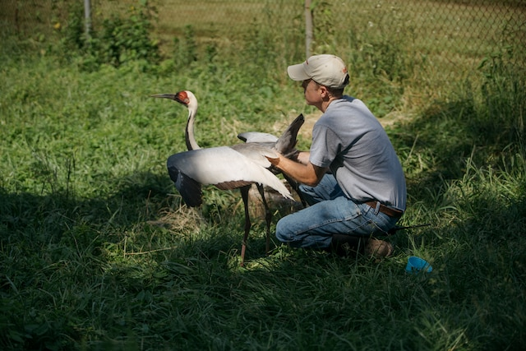
Keeper Design
Chris Crowe, a bird keeper. This keeper loves the birds class when he was a child. He came from another state’s zoo. When he arrived the zoo, he is in charge of the management of the crane park. one day a special female crane has given the birth, which has the “imprint” with the keeper. For the continues of this rare species, he took on the responsibility of caring for and accompanying this special white-naped crane. For this crane’s health, he need to feed, pet and clean her everyday. For other cranes’ sefety, because this female will attack other cranes when they get close, he need to seperate the female one away from others. His relationship with this crane becomes very close. His friends even his family don’t understand him and even got a lot of cyber-violence from Internet. He never stop take care of this crane and the work of saving this species.
Basic action:
Walking; Petting; Feeding; Lifting; Brushig; Throw fresibee; Driving other cranes away.
Reference:
The Washington Post, Story by Sadie Dingfelder Photos by Lexey Swall Illustrated by Laurène Boglio (JULY 23, 2018) https://www.washingtonpost.com/news/style/wp/2018/07/23/feature/the-crane-who-fell-in-love-with-a-human/

Slide 9
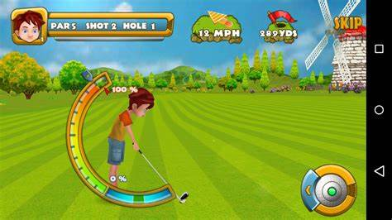
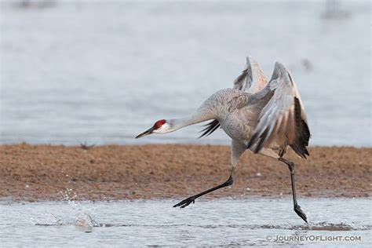
Interaction Design
Feed Keep food handy and feed it to the crane whenever its health drops. This action can be done while the rest of the process is going on. Player can also put food inside of the barn for crane to eat it by herself.
Clean Brush to clean the body of the crane and need to use the broom to clean the barn which the crane lives in. These tools are all located in storage.
Reference：
Golf Championship, CanadaDroid, 01 Jan 2014
http://app4smart.com/en/6919-golf-championship.html
Play Throw a frisbee to a white-naped crane to catch in the air and bring it back. The way that player throw the frisbee is like the way hitting the golf ball in the golf game. there is a bar with different zones, player need to keep the pointer stay in the middle to throw a good one. In this part, if the crane doesn’t have enough level of intimacy with the player, it will fail a lot.
Protect Protect other cranes avoid the attack from the human-imprinted crane. Because the human-imprinted crane treat the player as the other half, so in her opinion, if other cranes are trying to get close to the player, the human-imprinted crane will attack these crane even kill them to secure her rights as a partner. If the human-imprinted crane kills another crane, the game will be over.
When this event happens, the camera will move to the righ edge of the map and show the player there is a male crane getting close to the female one.
Player need to hurry up, walking to the male crane and drive him leave the map to avoid him get hurt by the female one.

Slide 10
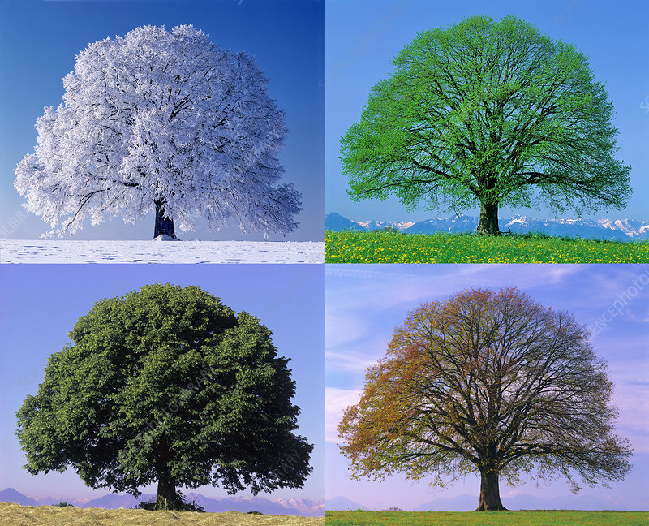
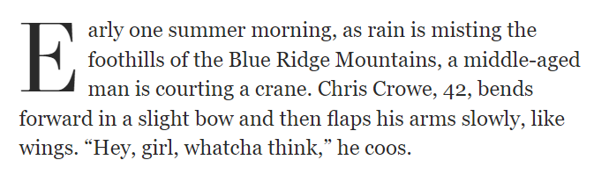
Timeline Design
The timeline of the game is four seasons with one year. Each season is separated into three days. Everyday the player can do all the actions they want and the time of one day is 12 minuets maximum. Player can click the next day button to skip the day. In the end of the spring of next year, the player need to do the final action, which is artificial insemination and let the crane lay the egg.
Background Story
In July 23, 2018, The Washington Post posted a real story happened in a SCBI in US. Chris Crowe, SCBI’s newest keeper. A female white napped crane “imprint” him and act as his mate. A beautiful story about human and animals.
“If she’s still here when I’m eligible for retirement, I won’t be able to leave,” Crowe says. “I’d feel like a jerk.”

